Slide 1
SRAM Interfacing with 8086 CPU

Slide 2
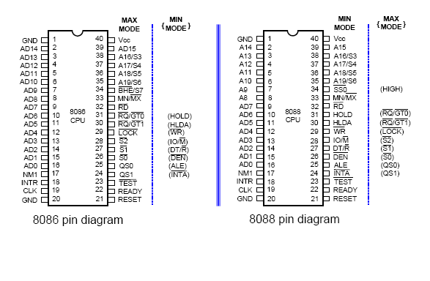

Slide 3
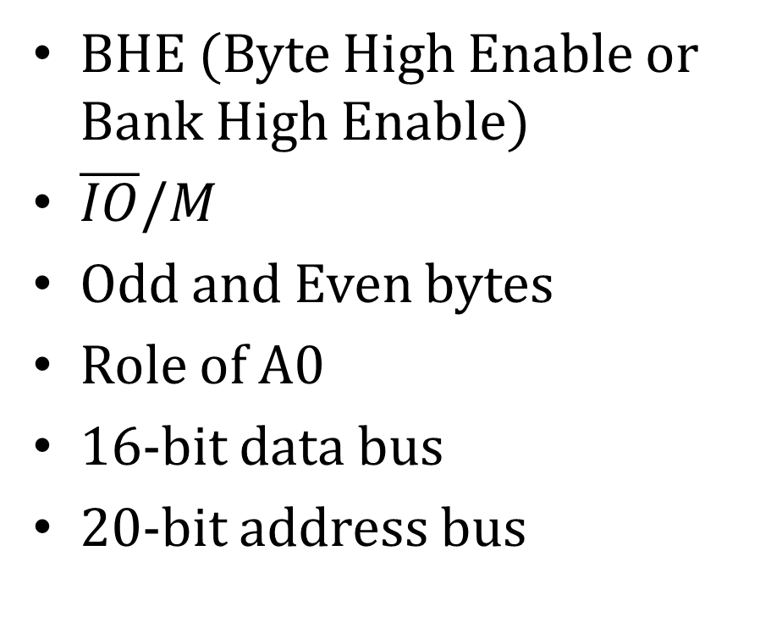
Memory Interfacing with 8086 CPU
BHE (Byte High Enable or Bank High Enable)
$\overline{IO}/M$
Odd and Even bytes
Role of A0
16-bit data bus
20-bit address bus

Slide 4
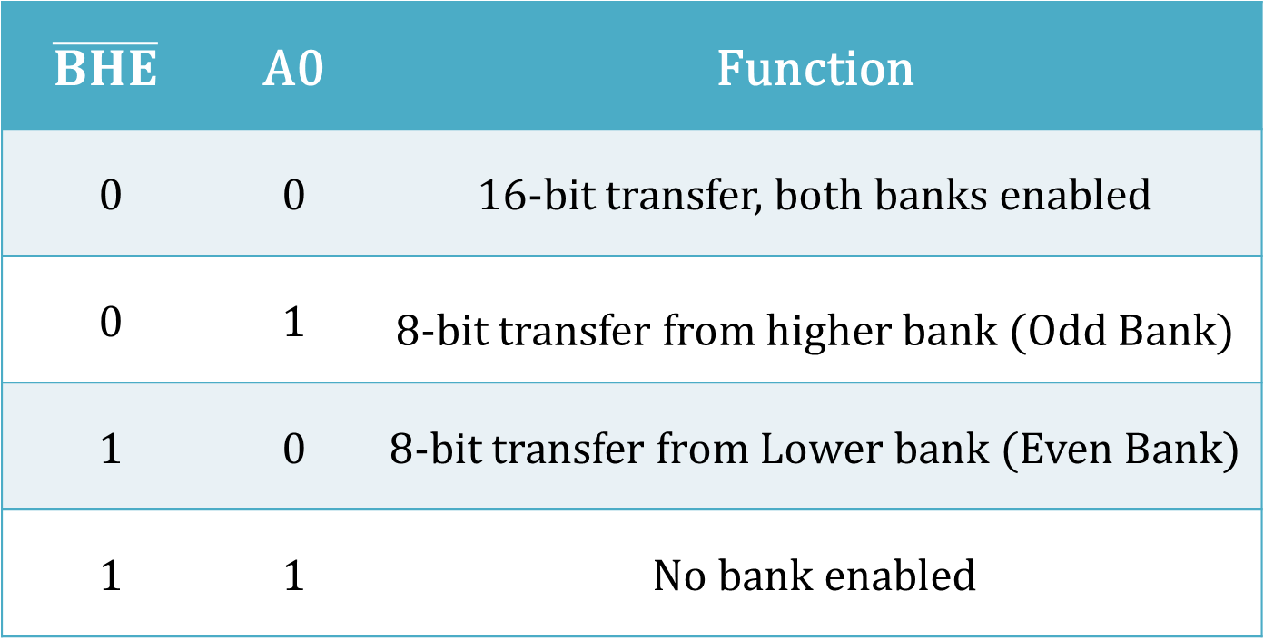
Bank Selection Table
$$\overline{BHE}$$ | A0 | Function
0 | 0 | 16-bit transfer, both banks enabled
0 | 1 | 8-bit transfer from higher bank (Odd Bank)
1 | 0 | 8-bit transfer from Lower bank (Even Bank)
1 | 1 | No bank enabled

Slide 5
Separate Bank Selection (Example)
Separate decoders are required for each bank
Example describes 1MB SRAM interfacing with 8086 CPU
Memory map for total memory will be
00000H to FFFFFH

Slide 6
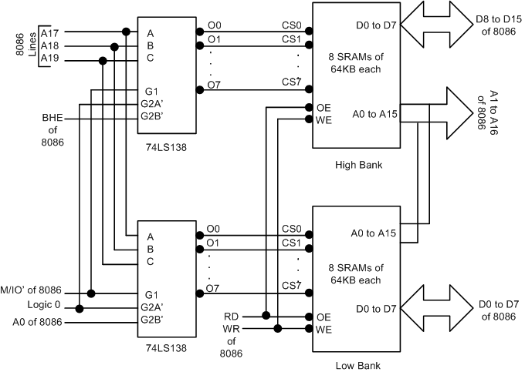

Slide 7
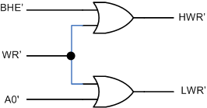
Separate Write Strobe Approach

Slide 8
256KB SRAM Interfacing (Example)
Using 64KB SRAM chips
4 SRAM chips will be used
Total memory map is from C0000H and above
For low bank (MEM_L0 and MEM_L1)
For high bank (MEM_H0 and MEM_H1)

Slide 9
Memory maps
For MEM_L0: C0000H to DFFFEH
For MEM_L1: E0000H to FFFFEH
For MEM_H0: C0001H to DFFFFH
For MEM_H1: E0001H to FFFFFH
Total locations accessed:
FFFFFH-C0000H = 3FFFFH (256K)

Slide 10
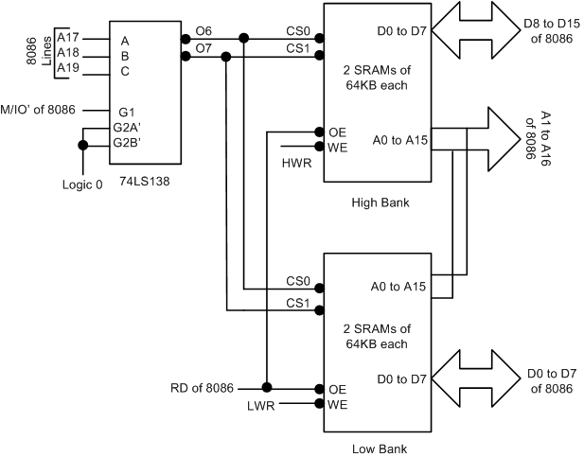

Slide 11
RD Operation in Separate Write Strobe Approach
From last figure, when O6 is active, both CS0s in High bank and Low bank are enabled and data can be read from both banks, as RD is connected to both the banks.
When O7 is active, both CS1s in High bank and Low bank are enabled and data can be read from both banks, as RD is connected to both the banks.

